Slide 1
CITY OF OLATHE Proposed 2022 Audit Plan
Mary Ann Vassar, CPA, CRMA
City Auditor
May 3, 2022

Slide 2
2022 PROPOSED CITY AUDITOR WORKPLAN Overview and Development Approach
THE PROPOSED 2022 AUDIT PLAN WAS DEVELOPED THROUGH:
• Reviewing prior year’s 2021 surveyed City management and City Council audit priorities
• Completion of a City enterprise-level assessment of risk areas and risk exposure
• Discussion of these survey and risk assessment results with the City Council Audit Committee
• Developing an audit plan with the City Auditor’s available time resources including projects in requested areas and/or areas deemed to have relevant risk exposure

Slide 3
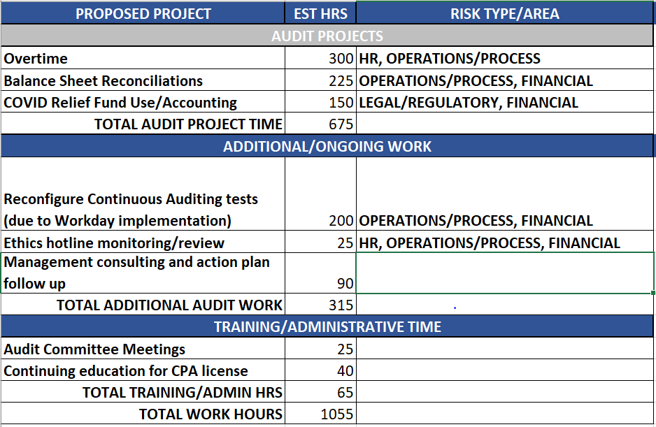
2022 PROPOSED AUDIT WORKPLAN
based on risk assessment and
surveyed priorities of the Council and City Manager Team

Slide 5
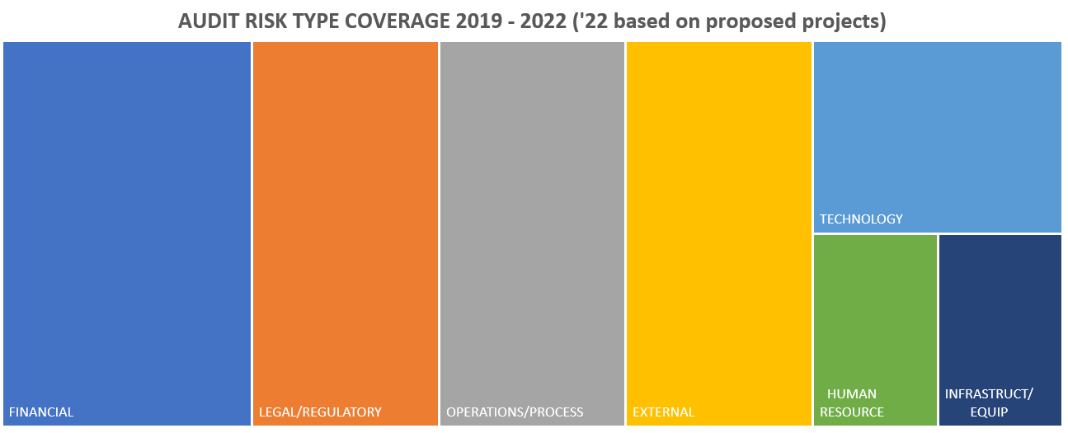
HISTORIC AUDIT RISK COVERAGE ANALYSIS:
2019-2022

