Slide 1
119th Street and I-35 Interchange Reconfiguration Project
Therese Vink
Sr. Project Manager
November 5, 2020

Slide 2
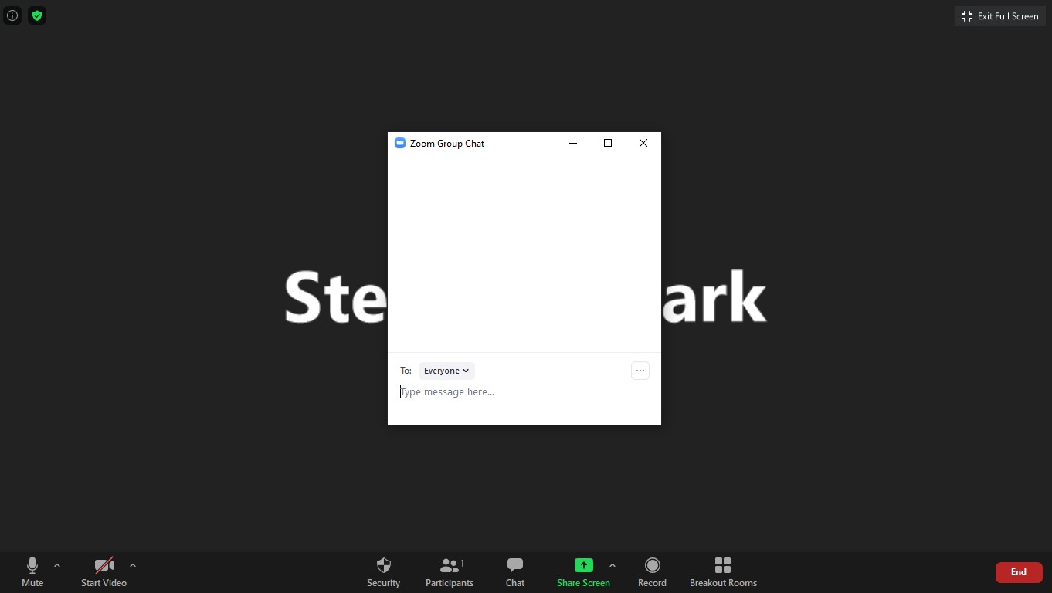
119th Street and I-35 - Agenda
This presentation will be repeated every 30 minutes throughout the duration of the meeting
The remainder of the time will be open for questions
There will not be the availability to unmute yourself as a participant
If there are questions, please use the Chat icon, generally located at the bottom or your screen
If I do not fully answer your question as you anticipated, please feel free to contact me directly after the meeting
Please utilize for all questions

Slide 3
119th Street and I-35 - Communication
For specific project information and updates throughout construction, please visit www.olatheks.org/119
There is also an area at the bottom of this website for questions or concerns
Construction updates will also be available for free through NotifyJoCo.org
By registering with NotifyJoCo and customizing your alert preferences, you’ll receive time-sensitive messages directly from the City relating to construction and traffic impacts as they pertain to the project
If you would like to receive e-mail updates on the project, please type your e-mail into the chat box

Slide 4
119th Street and I-35 - Project Overview
Reconfigure the interchange to a diverging diamond interchange
Widen the bridge over BNSF to accommodate 3 thru lanes of traffic
Geometric improvements at Renner Blvd
Widening 119th Street to accommodate 3 thru lanes of traffic from Renner Blvd to Strang Line Road

Slide 5
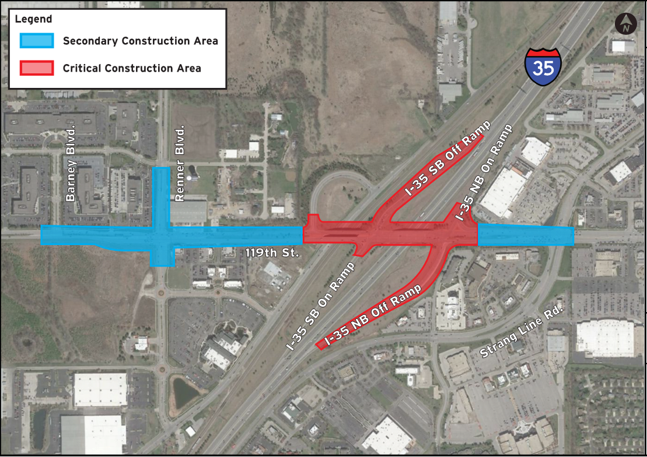
119th Street and I-35 - Construction Phasing

Slide 6
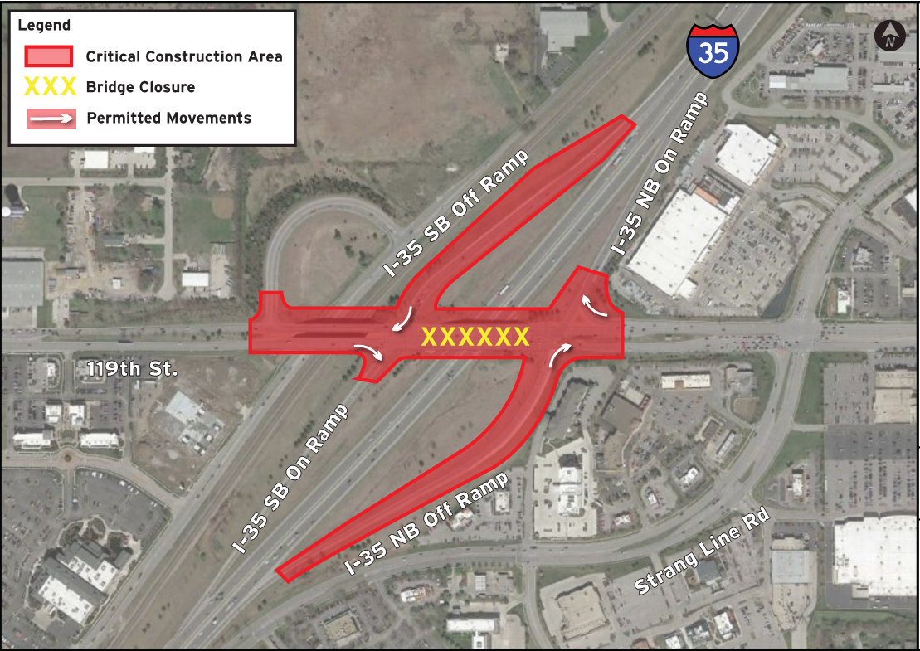
119th Street and I-35 - Construction Phasing

Slide 7
119th Street and I-35 - Schedule
Schedule
Start Construction on 119th Street – November 2020
Start Construction on BNSF Bridges – December 2020
Start Construction on 119th Street Bridge – Summer 2021
Closure of the 119th Street for 90 days between July and October 2021
Construction Completion – Spring 2022

Slide 8
119th Street and I-35 Project Contact Information
City of Olathe Miles Excavating (24-hr Emergency)
Therese Vink Richard Prater
913-971-9032 816-769-7286
tmersmann@olatheks.org richardp@milesexcavating.com

